Slide 1
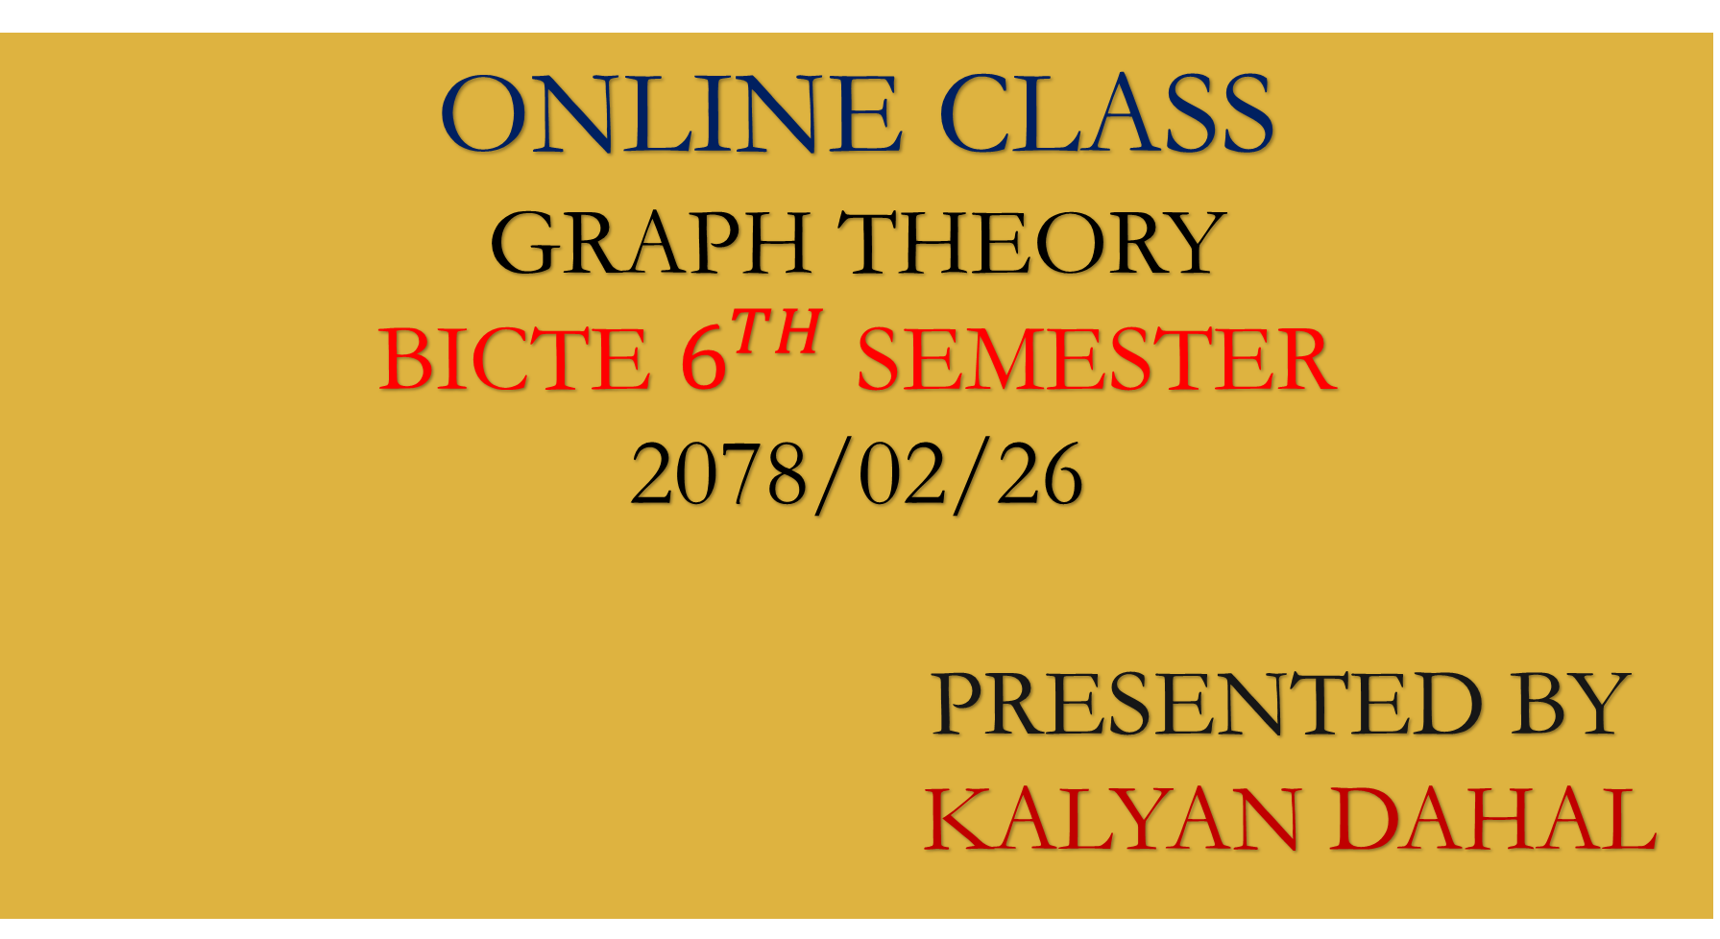
ONLINE CLASS
GRAPH THEORY
BICTE $6^{TH}$ SEMESTER
2078/02/26
PRESENTED BY KALYAN DAHAL

Slide 2
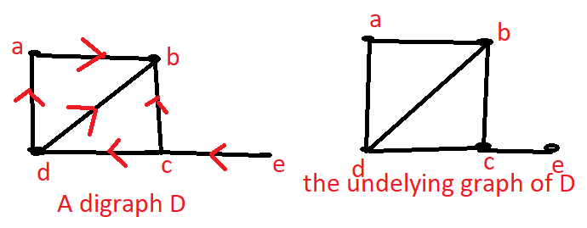

Connectivity of digraphs
Underlying graph:
The underlying graph G = (V, E) of a directed graph D = (V, A) has the vertex V and the edge set E = {{u, v}: (u, v) $∈$ A}.
The underlying graph G is obtained from the given digraph D by deleting all the arrow heads (allocated directions) from the edges of D.

Slide 3
Properties of underlying graph G of digraph D
G has the same diagram as that of D but without arrow-heads in the edges.
G has the same set of vertices as that of D.
G has the same set of edges which are connected in similar manner as that of D.
The graph G developed from digraph D having above three characteristics is called “underlying graph” of the digraph D.

Slide 4
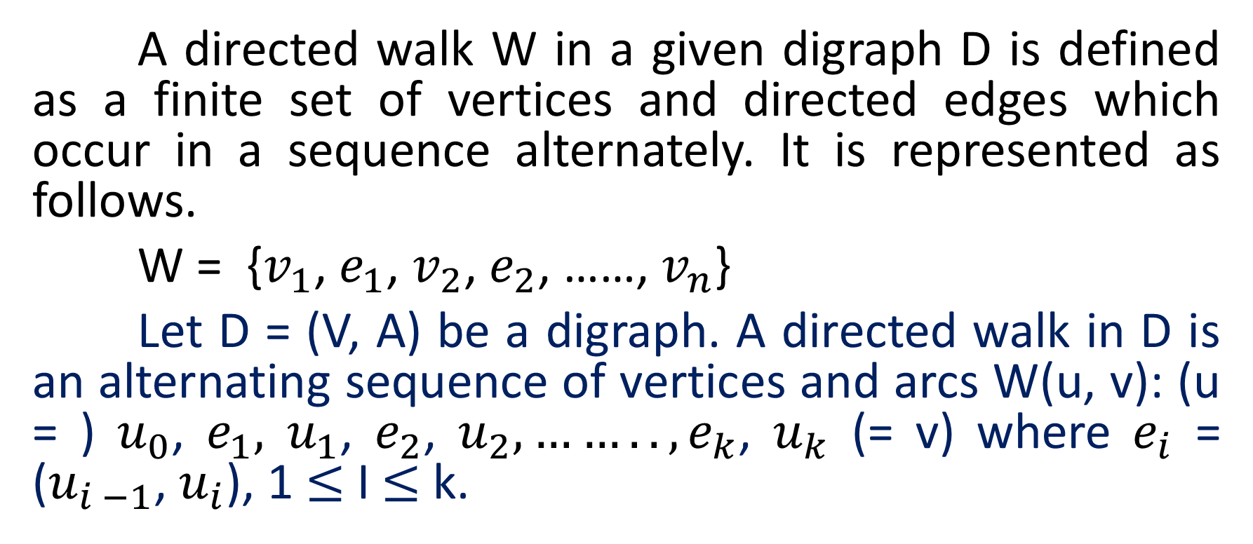
Directed walk
A directed walk W in a given digraph D is defined as a finite set of vertices and directed edges which occur in a sequence alternately. It is represented as follows.
W = {$v_{1}$, $e_{1}$, $v_{2}$, $e_{2}$, ……, $v_{n}$}
Let D = (V, A) be a digraph. A directed walk in D is an alternating sequence of vertices and arcs W(u, v): (u = ) $u_{0}$, $e_{1},$ $u_{1}$, $e_{2}$, $u_{2}, …….., e_{k}$, $u_{k}$ (= v) where $e_{i}$ = ($u_{i −1}$, $u_{i}$), 1 $≤$ I $≤$ k.

Slide 5
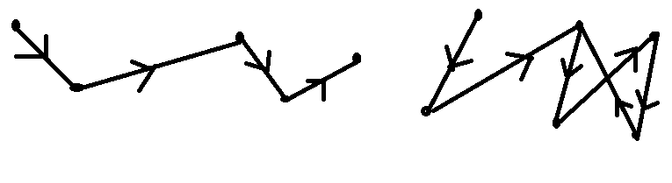












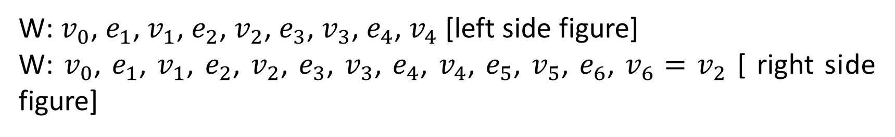









CONTINUED…..
$$v_{0}$$
$$v_{0}$$
$$v_{2}$$
$$v_{2}$$
$$v_{4}$$
$$e_{6}$$
$$e_{4}$$
$$v_{4}$$
$$e_{1}$$
$$e_{1}$$
$$e_{3}$$
$$e_{2}$$
$$e_{3}$$
$$v_{1}$$
$$e_{2}$$
$$v_{3}$$
$$e_{5}$$
$$v_{1}$$
$$e_{4}$$
$$v_{3}$$
$$v_{5}$$
W: $v_{0}$, $e_{1}$, $v_{1}$, $e_{2}$, $v_{2}$, $e_{3}$, $v_{3}$, $e_{4}$, $v_{4}$ [left side figure]
W: $v_{0}$, $e_{1}$, $v_{1}$, $e_{2}$, $v_{2}$, $e_{3}$, $v_{3}$, $e_{4}$, $v_{4}$, $e_{5}$, $v_{5}$, $e_{6}$, $v_{6}=$ $v_{2}$ [ right side figure]

Slide 6
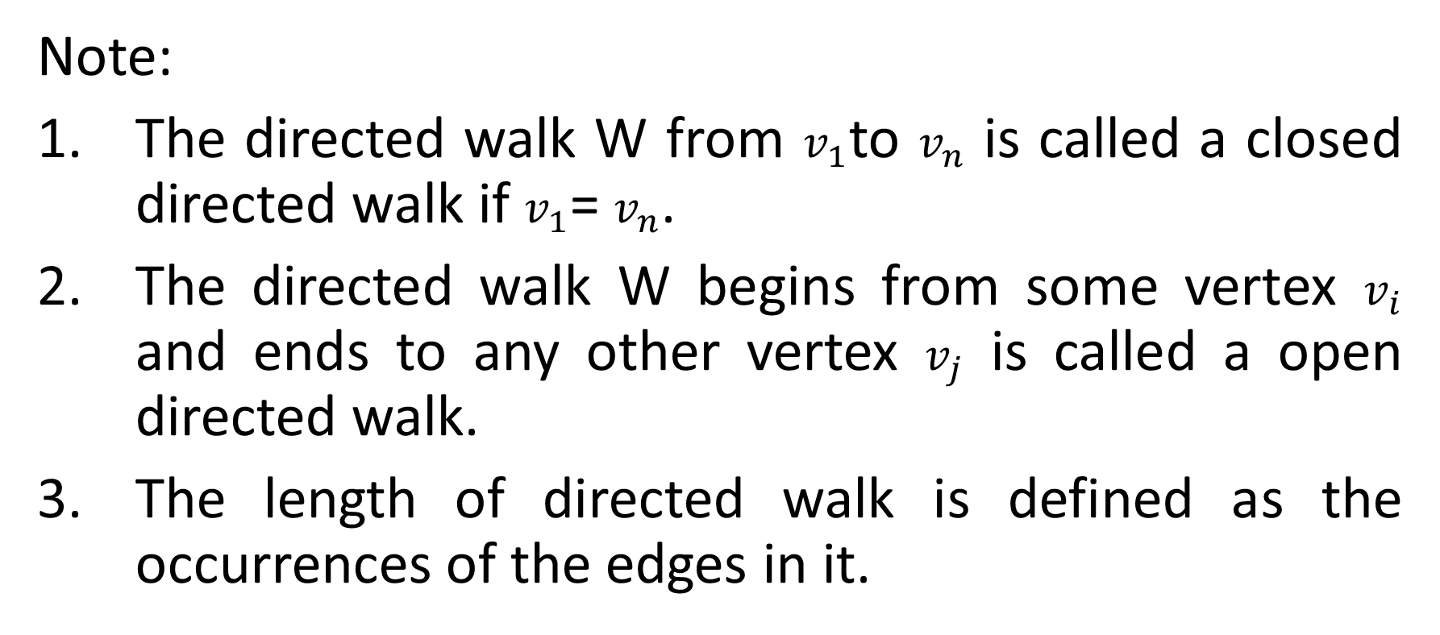
Continued…..
Note:
The directed walk W from $v_{1}$to $v_{n}$ is called a closed directed walk if $v_{1}$= $v_{n}$.
The directed walk W begins from some vertex $v_{i}$ and ends to any other vertex $v_{j}$ is called a open directed walk.
The length of directed walk is defined as the occurrences of the edges in it.

Slide 7












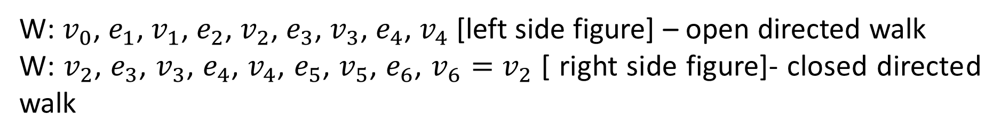









CONTINUED…..
$$v_{0}$$
$$v_{0}$$
$$v_{2}$$
$$v_{2}$$
$$v_{4}$$
$$e_{6}$$
$$e_{4}$$
$$v_{4}$$
$$e_{1}$$
$$e_{1}$$
$$e_{3}$$
$$e_{2}$$
$$e_{3}$$
$$v_{1}$$
$$e_{2}$$
$$v_{3}$$
$$e_{5}$$
$$v_{1}$$
$$e_{4}$$
$$v_{3}$$
$$v_{5}$$
W: $v_{0}$, $e_{1}$, $v_{1}$, $e_{2}$, $v_{2}$, $e_{3}$, $v_{3}$, $e_{4}$, $v_{4}$ [left side figure] – open directed walk
W: $v_{2}$, $e_{3}$, $v_{3}$, $e_{4}$, $v_{4}$, $e_{5}$, $v_{5}$, $e_{6}$, $v_{6}=$ $v_{2}$ [ right side figure]- closed directed walk

Slide 8
Directed path and cycle
Directed path:
A directed path is defined as an open directed walk with all distinct vertices and hence the edges.
An open directed walk W is called a directed path if all the vertices (and hence arcs) in W are distinct.
Directed cycle:
It is a directed path in all vertices are different except first and last vertices. Actually it is a closed directed path.

Slide 9
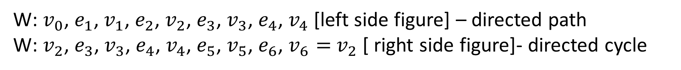
CONTINUED…..
$$v_{0}$$
$$v_{0}$$
$$v_{2}$$
$$v_{2}$$
$$v_{4}$$
$$e_{6}$$
$$e_{4}$$
$$v_{4}$$
$$e_{1}$$
$$e_{1}$$
$$e_{3}$$
$$e_{2}$$
$$e_{3}$$
$$v_{1}$$
$$e_{2}$$
$$v_{3}$$
$$e_{5}$$
$$v_{1}$$
$$e_{4}$$
$$v_{3}$$
$$v_{5}$$
W: $v_{0}$, $e_{1}$, $v_{1}$, $e_{2}$, $v_{2}$, $e_{3}$, $v_{3}$, $e_{4}$, $v_{4}$ [left side figure] – directed path
W: $v_{2}$, $e_{3}$, $v_{3}$, $e_{4}$, $v_{4}$, $e_{5}$, $v_{5}$, $e_{6}$, $v_{6}=$ $v_{2}$ [ right side figure]- directed cycle

Slide 10
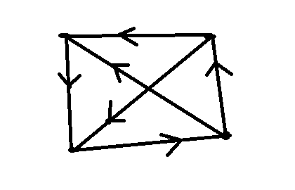











Spanning path
Spanning path:
spanning path is defined as a directed walk which contains all the vertices of a given digraph D.
Spanning path of given figure = {$v_{2}$, $e_{5}$, $v_{4}$, $e_{3}$, $v_{3}$, $e_{6}$, $v_{1}$}
$$v_{1}$$
$$e_{1}$$
$$v_{2}$$
$$e_{5}$$
$$e_{6}$$
$$e_{4}$$
$$e_{2}$$
$$v_{3}$$
$$v_{4}$$
$$e_{3}$$

Slide 11

Reachable path
Reachable path:
A vertex v is said to be reachable from a vertex u in a digraph D if there is a directed path from u to v.
Reachable path from $v_{1}$to $v_{2}$= {$v_{1}$, $e_{2}$, $v_{4}$, $e_{3}$, $v_{3}$, $e_{4}$, $v_{2}$}
$$v_{1}$$
$$e_{1}$$
$$v_{2}$$
$$e_{5}$$
$$e_{6}$$
$$e_{4}$$
$$e_{2}$$
$$v_{3}$$
$$v_{4}$$
$$e_{3}$$

Slide 12
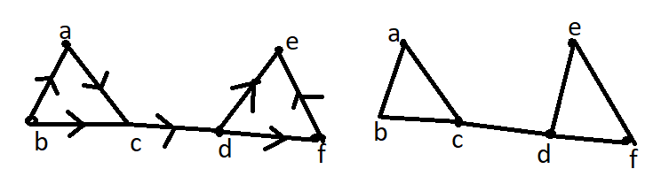
Connected digraph
Weakly connected:
A digraph D is said to be weakly connected if its underlying graph is connected. Otherwise it is said to be disconnected.
figure of weakly connected digraph

Slide 13
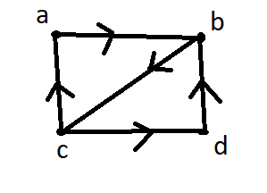
Strongly connected digraph
Strongly connected:
A digraph D is said to be strongly connected if every pair of vertices is reachable from another. i.e. there is a directed path from every vertex to every other vertex.
figure of strongly connected digraph

Slide 14
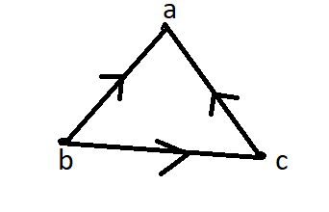
Unilaterally connected digraph
Unilaterally strongly connected:
A digraph D is said to be unilaterally connected if given any two vertices u and v, either there is a path from u to v or there is a path from v to u or not both the path.
figure of unilaterally connected digraph

Slide 15
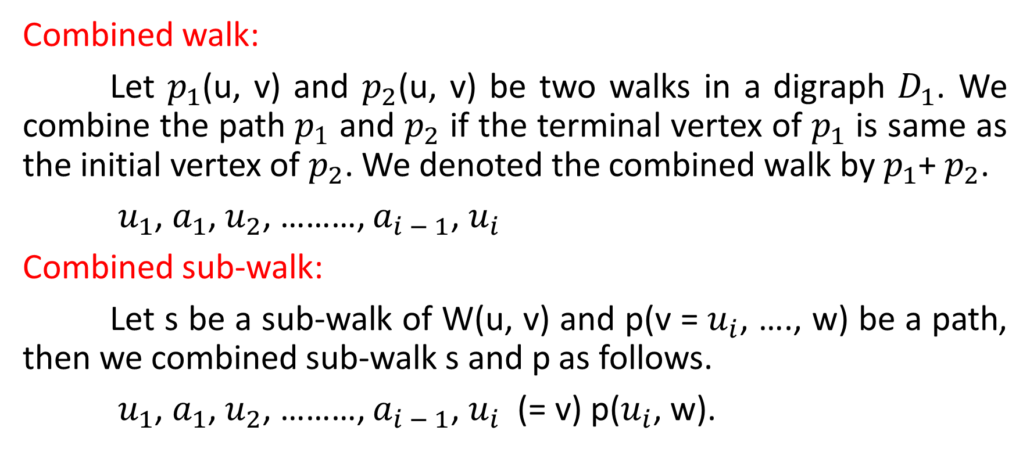
Combined walk and sub-walk
Combined walk:
Let $p_{1}$(u, v) and $p_{2}$(u, v) be two walks in a digraph $D_{1}$. We combine the path $p_{1}$ and $p_{2}$ if the terminal vertex of $p_{1}$ is same as the initial vertex of $p_{2}$. We denoted the combined walk by $p_{1}$+ $p_{2}$.
$u_{1}$, $a_{1}$, $u_{2}$, ………, $a_{i − 1}$, $u_{i}$
Combined sub-walk:
Let s be a sub-walk of W(u, v) and p(v = $u_{i}$, …., w) be a path, then we combined sub-walk s and p as follows.
$u_{1}$, $a_{1}$, $u_{2}$, ………, $a_{i − 1}$, $u_{i}$ (= v) p($u_{i}$, w).

Slide 16
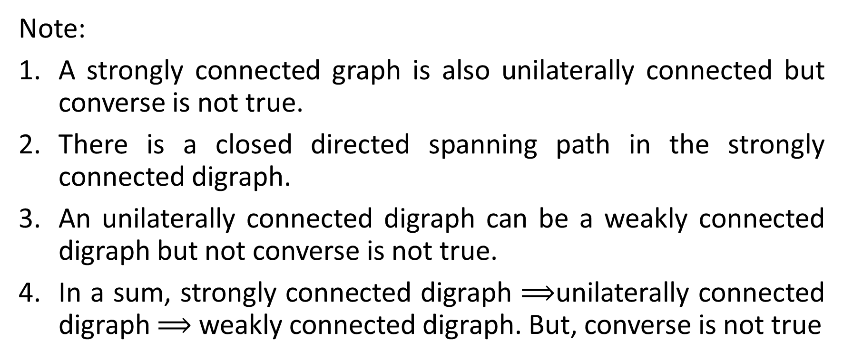
Continued…..
Note:
A strongly connected graph is also unilaterally connected but converse is not true.
There is a closed directed spanning path in the strongly connected digraph.
An unilaterally connected digraph can be a weakly connected digraph but not converse is not true.
In a sum, strongly connected digraph $⟹$unilaterally connected digraph $⟹$ weakly connected digraph. But, converse is not true

Slide 17
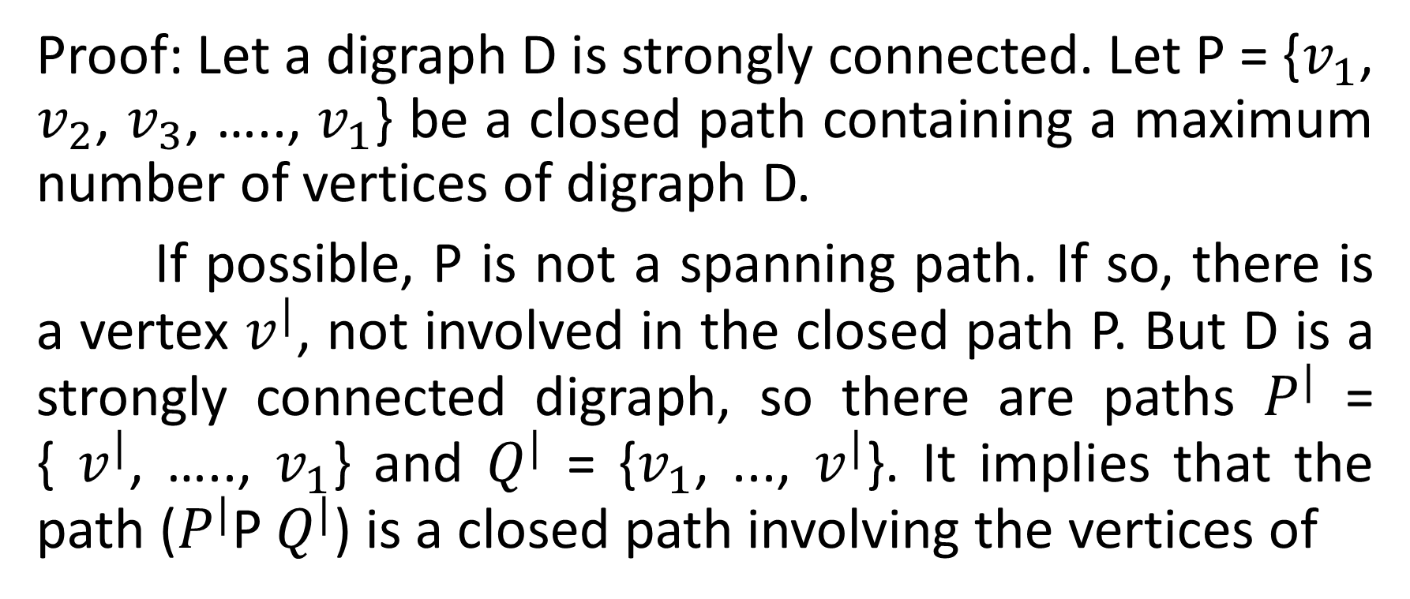
A digraph D is strongly connected iff it has a closed directed spanning path.
Proof: Let a digraph D is strongly connected. Let P = {$v_{1}$, $v_{2}$, $v_{3}$, ….., $v_{1}$} be a closed path containing a maximum number of vertices of digraph D.
If possible, P is not a spanning path. If so, there is a vertex $v^{|}$, not involved in the closed path P. But D is a strongly connected digraph, so there are paths $P^{|}$ = { $v^{|}$, ….., $v_{1}$} and $Q^{|}$ = {$v_{1}$, ..., $v^{|}$}. It implies that the path ($P^{|}$P $Q^{|}$) is a closed path involving the vertices of

Slide 18
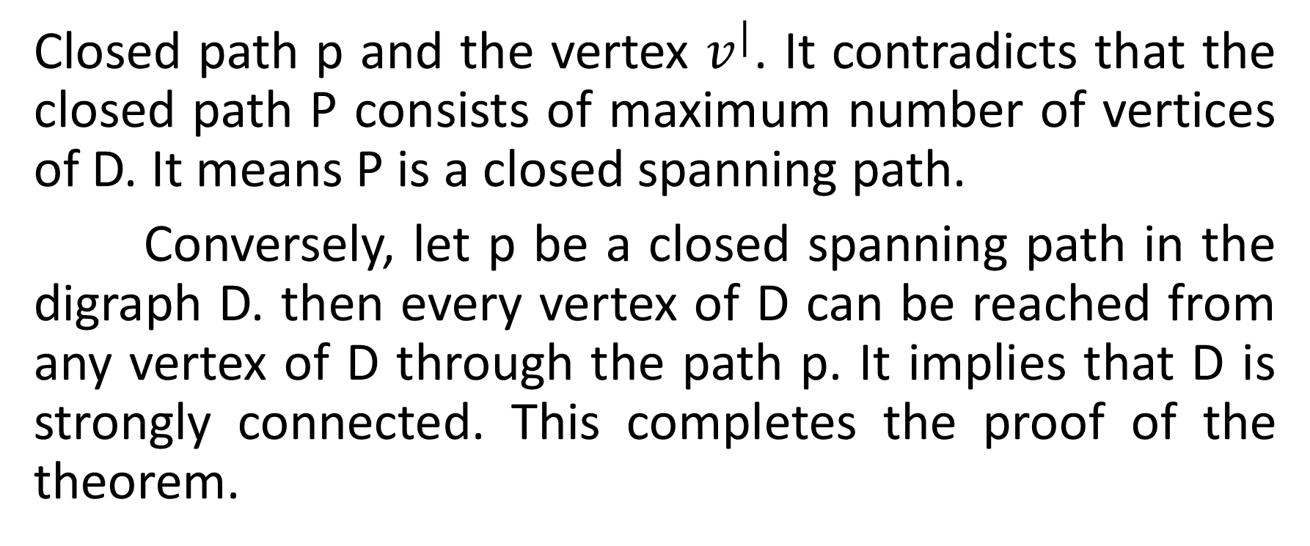
Continued…..
Closed path p and the vertex $v^{|}$. It contradicts that the closed path P consists of maximum number of vertices of D. It means P is a closed spanning path.
Conversely, let p be a closed spanning path in the digraph D. then every vertex of D can be reached from any vertex of D through the path p. It implies that D is strongly connected. This completes the proof of the theorem.

Slide 19


